Slide 1

N.B.K.R INSTITUTE OF SCIENCE & TECHNOLOGY
(Autonomous)
Vidyanagar, Tirupati - 524413
Customer Churning Prediction using XGBOOST and CATBOOST
Team Members (AI&DS):
1. Y. Samson(21KB1A30A2) 2. U. Siva Raju (21KB1A3093)
3. S. Sri Charan(21KB1A3089) 4. M. Lazar (21KB1A3054)
5. N. Charan Reddy(22KB5A3013)
Under the Guidance of
Mrs. P. Jyothi,
Assistant Professor,
Department of IT and AI&DS.

Slide 2
Index
Introduction
Literature Survey
Modules
System Architecture
Algorithm explanation

Slide 3
Introduction
Customer retention is essential for business success.
Retaining existing clients is more cost-effective than acquiring new ones.
Customer churn are the one who stopped using service of your business.
Traditional churn analysis focus on customer churn after it occurs. Our system predict churn before it happens.
Objective is to develop a superior machine learning system to predict customer churn.
Our system empowers businesses to implement more effective retention strategies, boosting customer lifetime value.

Slide 4
LITERATURE SURVEY
S.NO | TITLE | AUTHORS | YEAR | OUTCOMES
1 | MLPNN: Multi-layer perceptron neural network | Omar Adwan et al. | 2016 | The results recommend that the MLPNN and SVM models have higher preciseness and lower value practicality.
2 | Advanced regularization and clipping techniques | M.Feindta et al. | 2018 | K-Nearest Neighbors offers accurate predictions. Random Forest is preferred as it splits the trees based on a subset of features to improve the bagging. optimization of the model through feature engineering is suggested
3 | KNN, RF, and SVM | Edwine et al. | 2023 | The Stochastic Gradient Booster is preferred as it checks the training samples at random instead of all and helps to reach the global minimum faster.

Slide 5
MODULES
Module 1: Data Collection & Preprocessing
Data Source: Kaggle dataset: Telco Customer Churn.
Data Cleaning:
Removed irrelevant column ('customerID').
Handled missing values in 'TotalCharges' by replacing them with 0.0.
Converted 'TotalCharges' to a numerical data type (float).
Addressing Data Imbalance:
Observed class imbalance in the 'Churn' variable.
Applied SMOTE (Synthetic Minority Over-sampling Technique) to balance the dataset and improve model performance.

Slide 6
Module 2: Exploratory Data Analysis (EDA)
Insights:
Analyzed numerical features ('tenure', 'MonthlyCharges', 'TotalCharges') using histograms and box plots, revealing distributions and potential outliers.
Explored categorical features using count plots to understand their frequencies and relationships with churn.
Calculated the correlation between numerical features using a heatmap.
Findings:
Identified patterns in customer behavior based on tenure, monthly charges, and total charges.
Observed relationships between categorical features and churn, such as contract type and internet service.

Slide 7
Module 3: Feature Engineering & Selection
Encoding Categorical Features:
Used Label Encoding to convert categorical columns ('SeniorCitizen', 'gender', 'Partner', etc.) into numerical representations for model compatibility.
Stored encoders using pickle for future use.
Module 4: Model Selection and Training
Models Considered:
CatBoost and XGBoost.
Model Performance:
Used 5-fold cross-validation to increase accuracy.

Slide 8
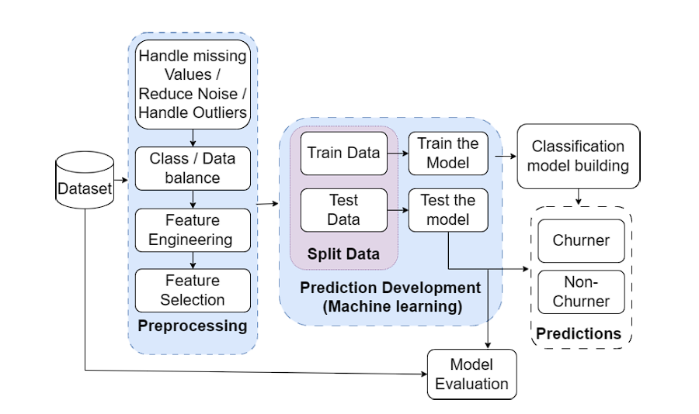
Architecture

Slide 9
Algorithm explanation
XGBoost (Extreme Gradient Boosting)
Introduction:
A powerful gradient boosting algorithm known for its high accuracy and efficiency.
Widely used in machine learning competitions and real-world applications.
Key Features:
Gradient Boosting: Builds an ensemble of decision trees sequentially, where each tree corrects the errors of its predecessors.
Regularization: Prevents overfitting by penalizing complex models, improving generalization.
Parallel Processing: Utilizes multiple cores for faster training.
Handling Missing Values: Built-in capabilities to handle missing data without imputation.
Advantages:
High predictive accuracy.
Handles missing vscalable.alues effectively.
Feature importance analysis.

Slide 10
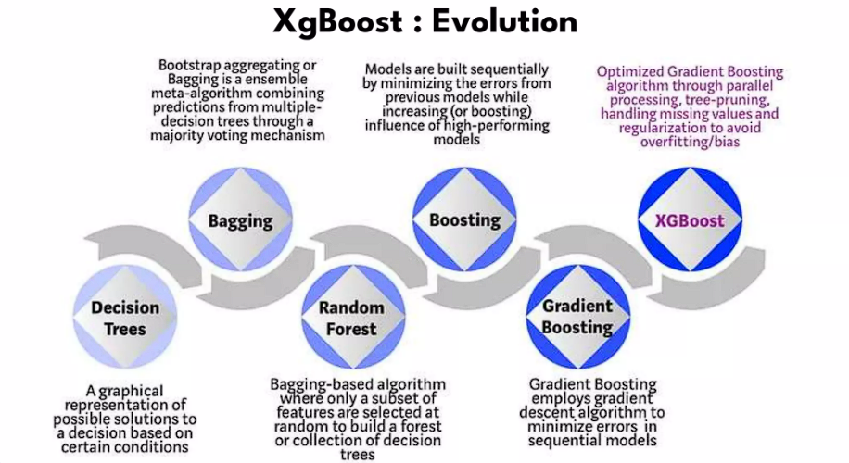
Start with an initial prediction:
This could be a simple average or a basic model.
Build a decision tree:
This tree tries to predict the errors in the initial prediction.
Add the tree's predictions to the initial prediction:
This improves the overall prediction.
Repeat steps 2 and 3:
Build more trees, each focusing on the remaining errors, until a stopping criterion is reached.

Slide 11
CatBoost (Categorical Boosting)
Introduction:
A gradient boosting algorithm designed to handle categorical features effectively.
Developed by Yandex and known for its robust performance on datasets with categorical variables.
Key Features:
Ordered Boosting: Reduces overfitting by using a novel boosting scheme that avoids target leakage.
Categorical Feature Handling: Automatically handles categorical features without the need for explicit encoding.
Fast and Scalable: Optimized for speed and efficiency.
GPU Support: Enables faster training on GPUs.
Advantages:
Excellent performance with categorical data.
Reduced overfitting.
Fast and scalable.
Improved accuracy compared to traditional gradient boosting methods.

Slide 12
ThankYou

